Slide 1


Consumer Man
Temporary Title - Jonathan Renteria

Slide 2
Concept, Rules, Requirements
[Concept: Ghostman seeks revenge in Pac Man's domain after Pac Man stole its glowing balls. Ghostman, a spectral guardian residing in the ghostly realm, discovers that the radiant orbs sustaining their ethereal domain have been pilfered by Pac Man. Driven by a quest for vengeance, Ghostman materializes in Pac Man's maze, determined to retrieve the stolen orbs and safeguard the delicate balance of their spectral world.]
[Rules: Collect glowing balls, avoid young Pac Man. Ghostman must navigate through the maze, collecting the glowing orbs scattered across the labyrinth. However, the spectral guardian must remain vigilant and avoid encounters with young Pac Man, who roams the maze seeking to consume Ghostman. The objective is to collect all glowing orbs while strategically outmaneuvering potential threats.]
[Requirements: Enhancements, unique implementations. - Dynamic Maze Structures: The maze will evolve dynamically, introducing new challenges and strategic elements as Ghostman progresses. - Ghost Abilities: Ghostman can unlock special abilities, enhancing maneuverability or temporarily deterring young Pac Man. - Time-based Challenges: Some levels may feature time constraints, adding an extra layer of urgency and excitement.]]

Slide 3
Design

Slide 4
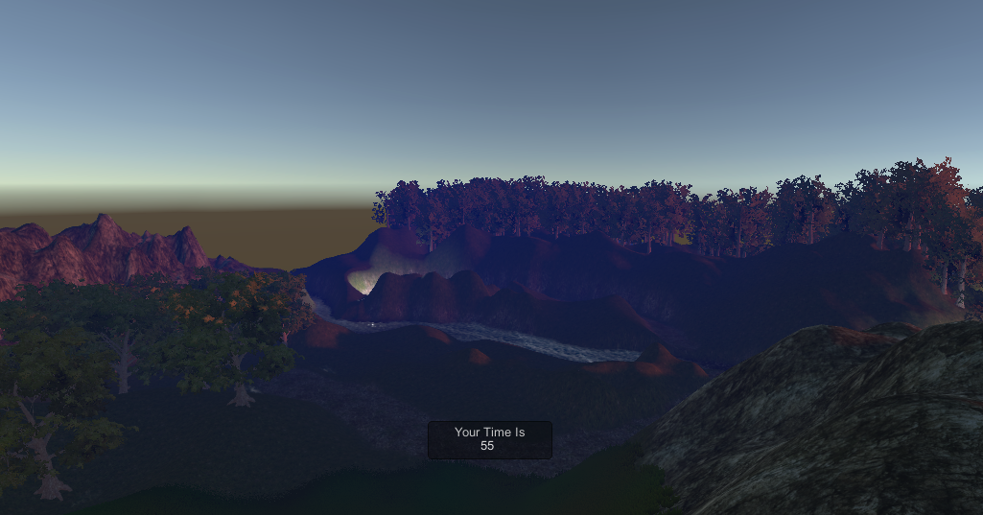
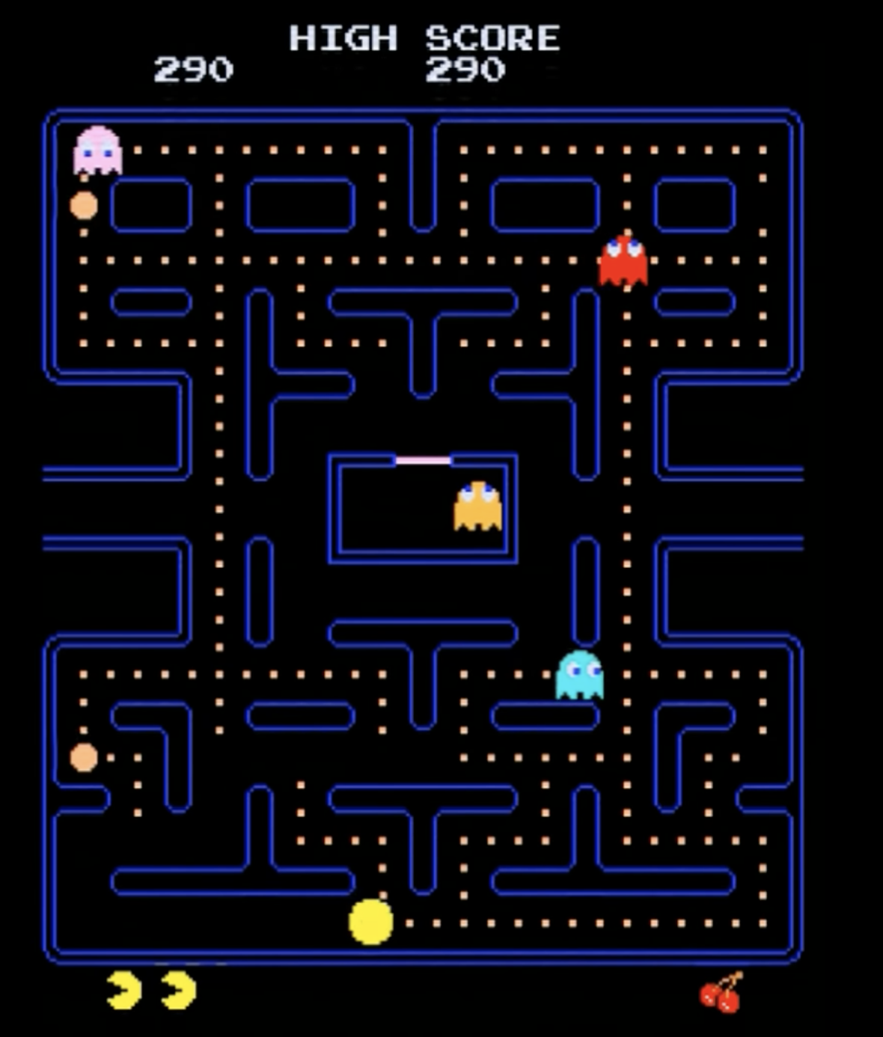
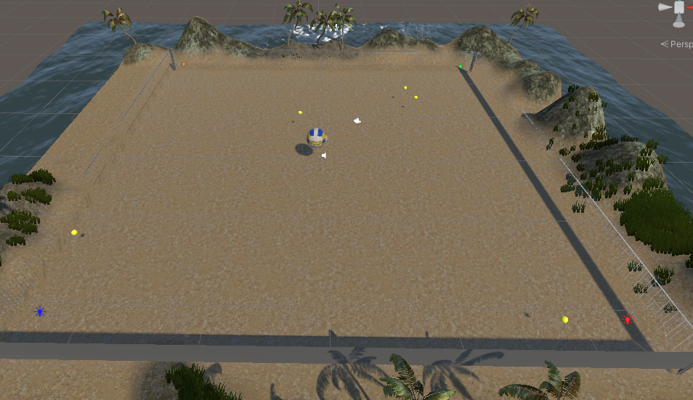
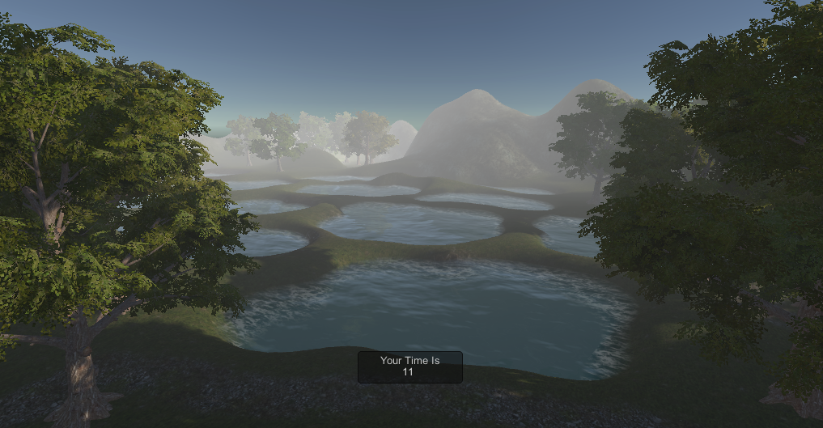
Level Design
Pac-Man Overworld
Hour 6 Amazing Racer
Hour 10 Chaos Ball
The level design will draw inspiration from previous projects to meet the rubric requirements, building upon established knowledge and skills. Additionally, it will incorporate elements inspired by Pac Man but with a three-dimensional (3D) twist. This approach aims to leverage past experiences while introducing a fresh perspective to the game environment.

Slide 5
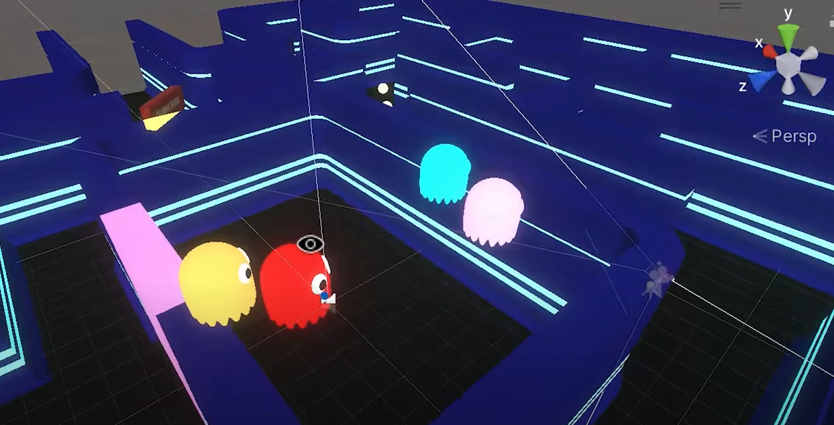
Level Design

Slide 6
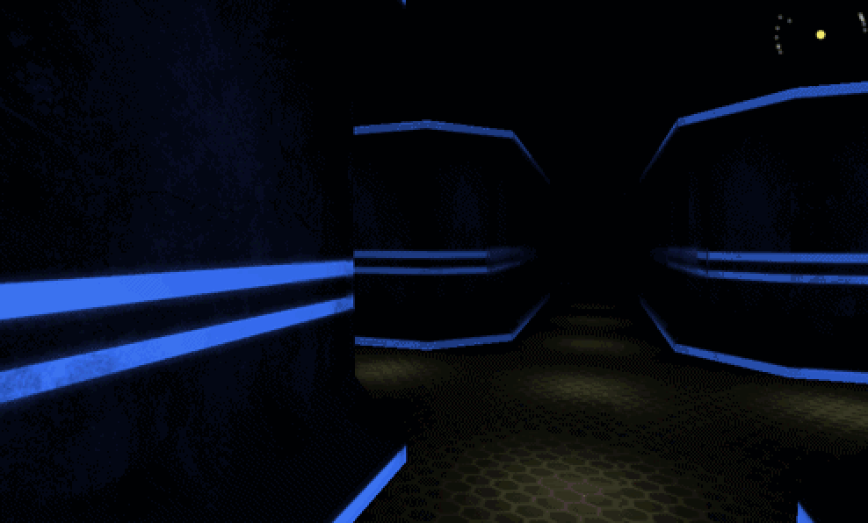
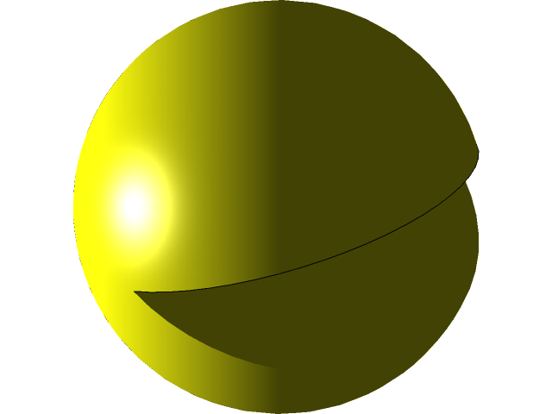



Design
The game will offer a unique experience by blending elements reminiscent of Pac-Man with a modern twist, adopting a first-person perspective in a three-dimensional (3D) environment. The player's viewpoint will be from a first-person perspective, with the camera positioned slightly behind the player, a design choice reminiscent of successful implementations in our previous projects.

Slide 7
Game Concept
Game concept is well thought out and flushed out. The concept is well articulated and detailed.

Slide 8
Rules
Rules are well thought out and flushed out. They are well articulated and detailed.

Slide 9
Requirements
Game Manager:
Develop a robust game manager system that oversees key game functions, including level progression, scoring, and player interactions. The game manager should effectively handle events triggered by player actions and dynamically respond to changes in the game state.
Particle Effect for Glowing Ball:
Implement visually appealing particle effects for the glowing orbs. The effects should enhance the ethereal atmosphere, making the collection of orbs a visually satisfying and immersive experience.
First-Person Controller (Unity Asset Store):
Integrate a reliable first-person controller from the Unity Asset Store. Ensure that the controller provides smooth and responsive navigation, allowing players to explore the 3D maze comfortably.
Enemies (Unity Asset Store):
Acquire and integrate enemy assets from the Unity Asset Store. These assets should represent young Consumer-Man counterparts, and their behaviors should align with the game's rules. Ensure that the enemies enhance the challenge while providing engaging interactions for the player.

Slide 10
Requirements
Rectangular Terrain; A Forest with Mist for Future Levels (Unity Asset Store):
Obtain assets from the Unity Asset Store to create a rectangular terrain for the initial maze. Consider incorporating a forest environment with mist for future levels, enhancing the visual diversity and atmosphere. Ensure that the assets seamlessly blend with the ghostly theme of the game.
Textures and Environment (Unity Asset Store):
Source high-quality textures to enhance the visual appeal of the game environment. Additionally, acquire assets from the Unity Asset Store to complement the overall ghostly atmosphere, such as eerie lighting or thematic elements that align with the game concept.
Ghost Animation:
Develop or obtain ghost animations to bring Ghostman to life. Implement animations for Ghostman's movements, interactions with orbs, and any special abilities. Ensure that the animations contribute to the overall immersive experience.
Wall Prefabs:
Create or obtain wall prefabs to construct the maze structures. Ensure that the walls align with the visual aesthetics of the game and contribute to the maze's complexity. Consider variations in wall design to enhance the overall visual interest.

Slide 11
Layout
Next create a storyboard that shows the layout of your game, see the Final Project assignment link and rubric for what you need to do for your final project. A fast reminder of a story

Slide 12
Story

Slide 13
Game Visualization
At least 5 slides visualizing the overall layout, beginning, middle and end of the game. Slides allow us to pictures a walkthrough of what the game will be.

